Slide 1

Geethanjali College of Engineering
Design and Analysis of Algorithms
Topic :Dijkstra’s Algorithm

Slide 2
What is Dijkstra’s Algorithm?
• Proposed by Edsger W. Dijkstra
• Finds shortest paths from a source node
• Works on non-negative weighted graphs

Slide 3
Problem Statement
Input:
  • Graph (V, E)
  • Source node
Output:
  • Shortest distance to all nodes

Slide 4
Core Idea
• Greedy approach
• Always pick the minimum distance unvisited node
• Relax edges (update distances)
💡 Think: expanding a ripple from the source 🌊

Slide 5
Algorithm Steps
1. Initialize distances (∞, source = 0)
2. Use priority queue
3. Extract min distance node
4. Relax neighbors
5. Repeat

Slide 6
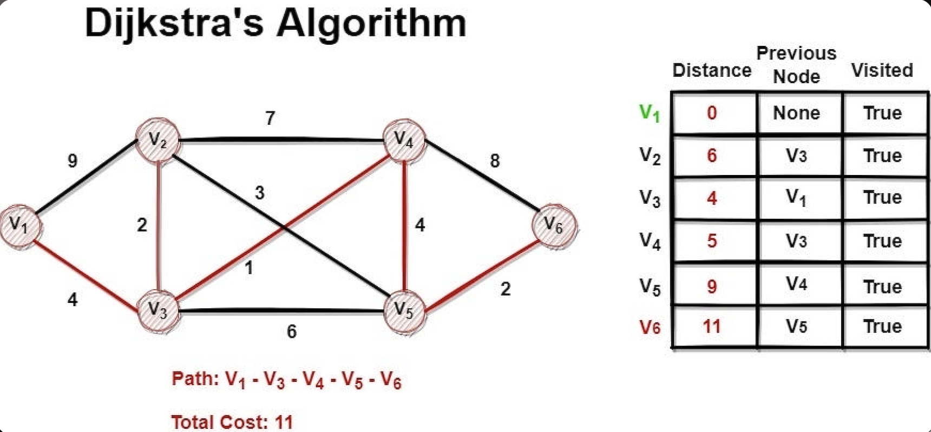
Example Graph
Explanation:
The Path starts from vertex V1 and the next vertex is chosen by the minimal edge from the vertex V1 and the process continues till all the vertexes are visited

Slide 7
Pseudocode
Initialize dist[source] = 0
All others = ∞
While PQ not empty:
u = node with min distance
for each neighbor v:
if dist[u] + weight < dist[v]:
update dist[v]

Slide 8
Time Complexity
• Without heap → O(V²)
• With Min Heap → O((V + E) log V)

Slide 9
Edge Cases
1. Negative Edge Weights ❌
• Dijkstra fails
• Example: A → B (-5) breaks logic
👉 Use Bellman-Ford instead
2. Disconnected Graph 🌑
• Some nodes remain at ∞
• Means: no path exists
3. Multiple Shortest Paths 🔀
• Algorithm finds one, not all
• Depends on traversal order
4. Cycles in Graph 🔄
• Works fine
• But must avoid infinite loops using visited set

Slide 10
Limitations and Alternatives
Limitations:
• Cannot handle negative weights
• Memory heavy for dense graphs
Alternatives:
• Bellman-Ford → negative edges
• Floyd-Warshall → all pairs

